Slide 1
KPMG Virtual Internship
Sprocket Central Pty Ltd Data Set:
Data Quality Review, Exploration, Model development and Interpretation

Slide 2
Data Exploration/Data Quality Assessment Adopted the Industry Standard Data Quality Dimensions for Data Assessment
Initial Observations on the available: 4 Datasets
CustomerDemographic table
NewCustomerList
Transactions
CustomerAddress
UNIQUENESS: All duplicated records in all tables to removed.
COMPLETENESS: Null columns in all tables to be removed; empty cells e.g., 3% Lastname empty in customerdemographic table.
CONSISTENCY: Contradicting values to be updated e.g., Gender in CustomerDemographic table represented as Female, F, Female, Male, M etc. Stare in CustomerAddress VIC, Victoria, NSW, New South Wales.
RELEVANCY: Default column in CustomerDemographic table with meaningless data not relevant and would be dropped, also all null columns.
VALIDITY: Allowable values to be used e.g., represent Gender & State appropriately across all tables.
ACCURACY: Column quality of some columns indicated results may be influenced if accuracy not resolved e.g., empty cells less than 3% may be dropped.
CURRENCY: Verify values up to date between CustomerDemographic and NewCustomerList

Slide 3
Data Exploration/Data Quality Assessment Adopted the Industry Standard Data Quality Dimensions for Data Assessment
Steps Taken to Improve Quality of the 3 Datasets provided by Sprocket Central Pty Ltd.
Transaction Table:
Added a ‘Profit’ column to the Transaction Table in the excel workbook.
Applied Steps:
Use 1st row as headers
Check column quality: Columns with null values removed; other null values reviewed as indicated.
Columns with null values - columns 14 – 266 removed
Column ‘online_order’ datatype True/False changed to text to replace the 2% null values with N/A.
Column ‘brand’ null values replaced with undisclosed.
Columns ‘Brand’; ‘product_line’; ‘product_class’;’Product-Size’ ;’List_price & ‘Standard_cost with null values less than 1% removed
Column 13: product_first_sold_date datatype changed from whole number to date
Duplication removed
Customer Address Table
Applied Steps:
Use 1st row as headers.
Data Consistency: VIC/Victoria(VIC); NSW/New South Wales(NSW)
Check columns quality.
Remove all columns with null values (Column 7 – Column 256)

Slide 4
Data Exploration/Data Quality Assessment cont’d
Customer Demographic Table
Applied Steps:
Use 1st row as headers
Check columns quality (Last_name, DoB, job_title, default & tenure columns had missing data)
Removed empty Columns 14 – 26
Removed ‘default’ column with meaningless data.
Data Consistency: M/Male (Male), F/Female/Female (Female) & U (Undisclosed).
Column quality issues highlighted in “2” resolved as follows:
Last_name: Replace null values with NA (Not Available)
DOB: Missing values cannot be replaced as it introduces contradiction. Null values representing 2% (87 rows out of over 1000 rows) dropped.
Job_title: Null values replaced with NA
Tenure: null values replaced with zero(0)

Slide 5
Data Exploration/Data Quality Assessment cont’d
NewCustomerList:
DOB with less than 2% null values removed.
Replaced empty job titles with NA.

Slide 6
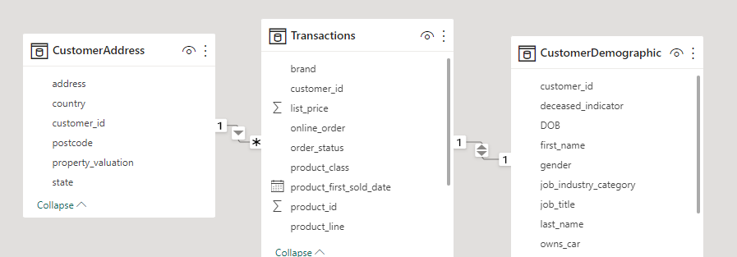
DATA MODEL DEVELOPMENT
Relationship Between the Tables
CustomerAddress / Transaction Tables: 1:* (one-to-many)
Transactions / CustomerDemographic:1:1 (one-to-one)

